Slide 1



Futurion
Portfolio Project
UPSKILLING INDIA
Lung Cancer Analysis
By Mayank Bhatt
19/2/2025
Tools used = MySQL and PowerBI
01

Slide 2

Futurion
Questions
UPSKILLING INDIA
Basic Level
1. Retrieve all records for individuals diagnosed with lung cancer.
2. Count the number of smokers and non-smokers.
3. List all unique cancer stages present in the dataset.
4. Retrieve the average number of cigarettes smoked per day by smokers.
5. Count the number of people exposed to high air pollution.
6. Find the top 5 countries with the highest lung cancer deaths.
7. Count the number of people diagnosed with lung cancer by gender.
8. Retrieve records of individuals older than 60 who are diagnosed with lung cancer.
Intermediate Level
1. Find the percentage of smokers who developed lung cancer.
2. Calculate the average survival years based on cancer stages.
3. Count the number of lung cancer patients based on passive smoking.
4. Find the country with the highest lung cancer prevalence rate.
5. Identify the smoking years' impact on lung cancer.
6. Determine the mortality rate for patients with and without early detection.
7. Group the lung cancer prevalence rate by developed vs. developing countries.
2
02

Slide 3
Futurion
Questions
UPSKILLING INDIA
Advanced Level
1. Identify the correlation between lung cancer prevalence and
air pollution levels.
2. Find the average age of lung cancer patients for each country.
3. Calculate the risk factor of lung cancer by smoker status,
passive smoking, and family history.
4. Rank countries based on their mortality rate.
5. Determine if treatment type has a significant impact on survival years.
6. Compare lung cancer prevalence in men vs. women across countries.
7. Find how occupational exposure, smoking, and air pollution
collectively impact lung cancer rates.
8. Analyze the impact of early detection on survival years.
03

Slide 4
Key Columns:
Demographics:
ID, Country, Population_Size, Age, Gender
Risk Factors:
Smoker, Years_of_Smoking, Cigarettes_per_Day,
Passive_Smoker,Family_History
Medical Details:
Lung_Cancer_Diagnosis, Cancer_Stage,
Survival_Years, Adenocarcinoma_Type
Environmental & Occupational Factors:
Air_Pollution_Exposure, Occupational_Exposure,
Indoor_Pollution
Healthcare & Treatment:
Healthcare_Access, Early_Detection, Treatment_Type
Mortality & Prevalence Data:
Developed_or_Developing, Annual_Lung_Cancer_Deaths,
Lung_Cancer_Prevalence_Rate, Mortality_Rate
Futurion
UPSKILLING INDIA
Dataset Description
Database Name: Lungcancer
Total Records: 220632
Total Columns: 23
Table Name: lung_cancer_data
04

Slide 5
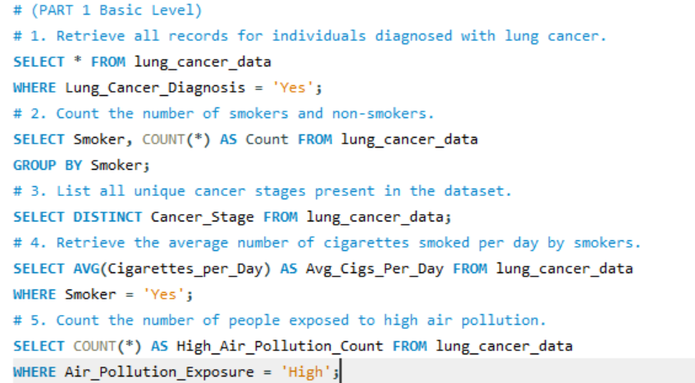

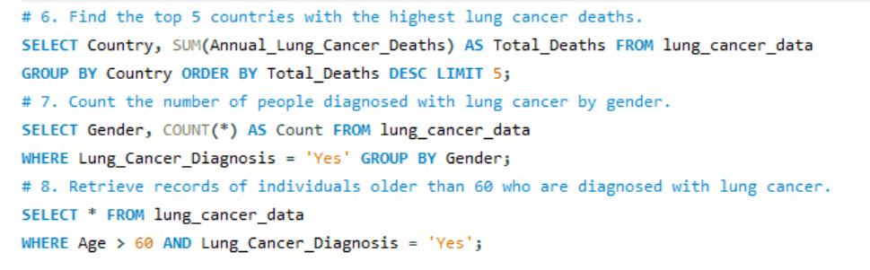
Futurion
Home
About us
Instructions
Tasks
Contact
UPSKILLING INDIA
05

Slide 6
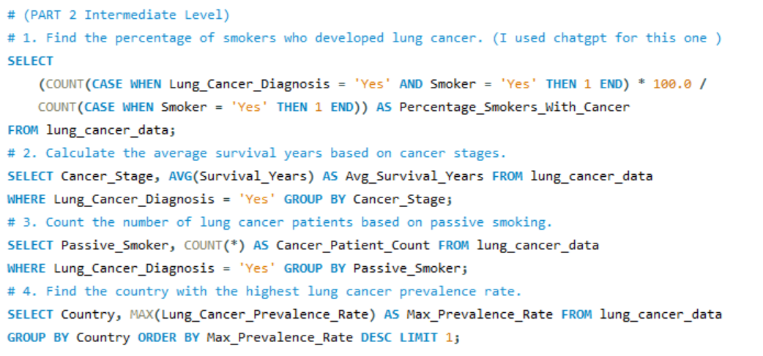
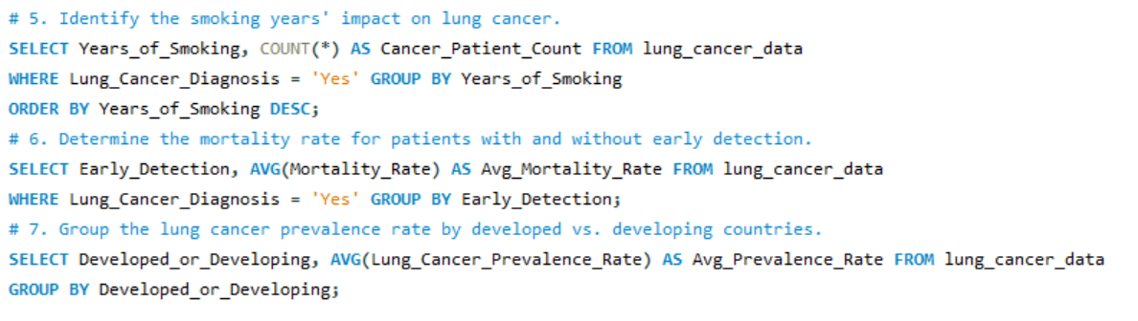
Futurion
Home
About us
Instructions
Tasks
Contact
UPSKILLING INDIA
06

Slide 7
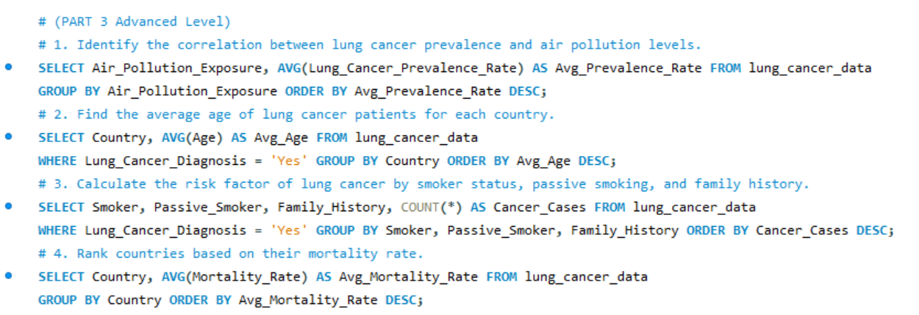
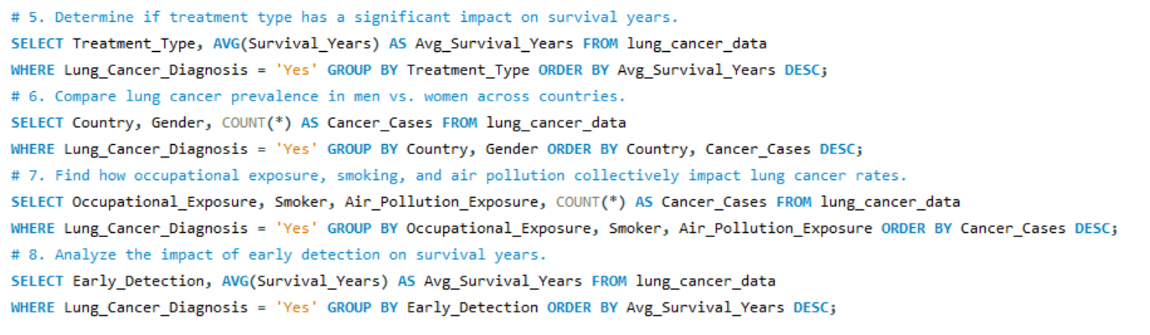
Futurion
Home
About us
Instructions
Tasks
Contact
UPSKILLING INDIA
07

Slide 8
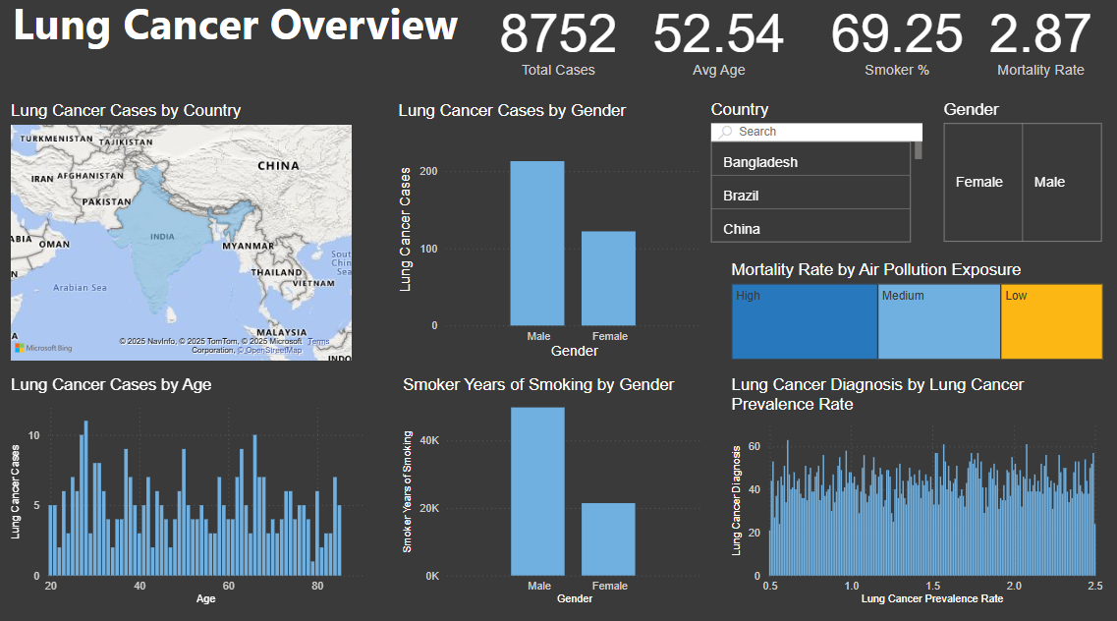
08

Slide 9

Key Insights from the Lung Cancer Dashboard
Total Cases & Demographics:
The dataset includes 8,752 total lung cancer cases with an average age of 52.54 years.
69.25% of the individuals are smokers, indicating a strong correlation between smoking and lung cancer.
The mortality rate is 2.87%, which provides an overall severity measure of the disease.
Geographical Distribution:
The "Lung Cancer Cases by Country" map highlights affected regions, showing a concentration in certain areas (e.g., Bangladesh, Brazil, and China are selectable).
This suggests that certain countries may have higher exposure to risk factors such as pollution, smoking, or lack of healthcare access.
Gender Disparity in Cases:
Males have significantly higher lung cancer cases than females.
Males also have more years of smoking exposure, reinforcing the link between long-term smoking and lung cancer.
Age-wise Lung Cancer Cases:
Cases are spread across different age groups, but there seems to be a higher concentration in middle-aged and older individuals.
This suggests that lung cancer risk increases with age, possibly due to prolonged exposure to risk factors.
Impact of Air Pollution on Mortality:
The mortality rate is highest in areas with high air pollution exposure, followed by medium and low exposure regions.
This confirms that air pollution is a critical factor in lung cancer-related deaths.
Lung Cancer Prevalence Rate & Diagnoses:
There is a clear correlation between lung cancer prevalence rates and the number of diagnoses.
Higher prevalence rates result in more diagnosed cases, possibly due to better healthcare access or higher exposure to risk factors.
09

Slide 10
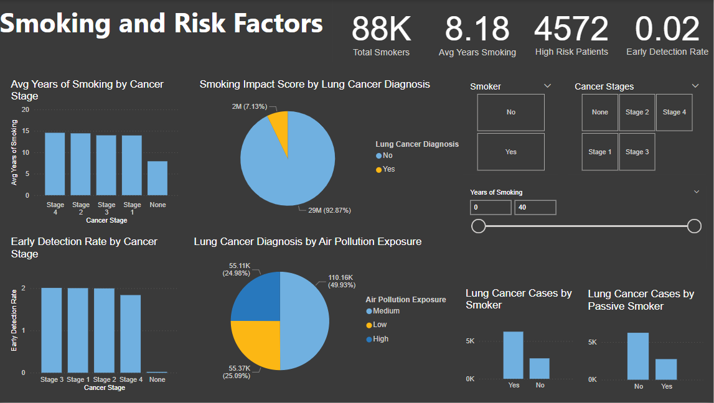
10

Slide 11
Key Insights from the Smoking and Risk Factors Dashboard
Smoking and Lung Cancer Risk:
There are 88K total smokers, with an average smoking duration of 8.18 years.
Out of the total population, only 7.13% of smokers were diagnosed with lung cancer, while 92.87% were not.
Smokers have a significantly higher number of lung cancer cases compared to non-smokers.
Cancer Stages and Smoking Duration:
Individuals in Stage 4 lung cancer have the highest average years of smoking, followed by Stage 3 and Stage 2.
Those with no cancer diagnosis have the lowest average years of smoking, reinforcing the link between long-term smoking and disease progression.
Early Detection Challenges:
The early detection rate is extremely low (0.02), indicating poor screening or delayed diagnosis.
Early-stage cancer detection (Stage 1 & 2) is slightly better than later stages, but overall rates remain concerning.
Impact of Air Pollution on Lung Cancer Diagnosis:
49.93% of lung cancer cases are associated with medium air pollution exposure, followed by low (25.09%) and high (24.98%).
This suggests that while high pollution is a risk, even moderate pollution levels significantly contribute to lung cancer cases.
Passive Smoking & Lung Cancer:
Passive smokers also show a high number of lung cancer cases, though lower than active smokers.
This highlights the dangers of secondhand smoke exposure, reinforcing the need for smoking restrictions in
public spaces.
11

Slide 12
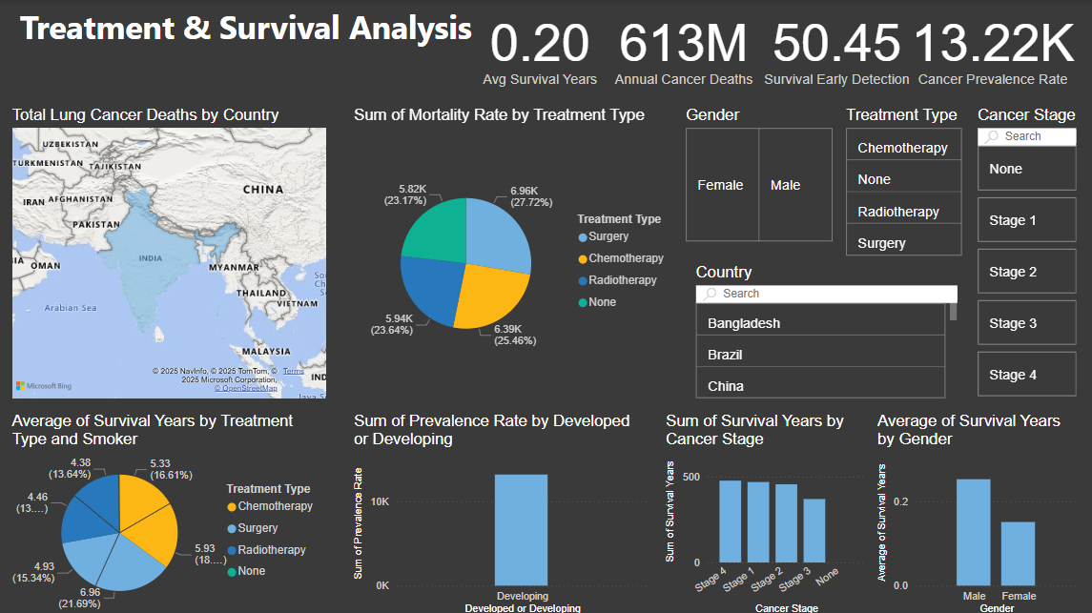
12

Slide 13
Key Insights from Treatment & Survival Analysis
Lung Cancer Overview
Total Cases: 8,752, with an average patient age of 52.54 years.
Smoking Impact: 69.25% of patients are smokers, indicating a strong correlation between smoking and lung cancer.
Gender Disparity: Males have higher lung cancer cases and more smoking years than females.
Mortality & Air Pollution: Higher air pollution exposure correlates with increased mortality rates.
Smoking & Risk Factors
Total Smokers: 88K, with an average smoking duration of 8.18 years.
Lung Cancer & Smoking: The majority of lung cancer cases occur in smokers, reinforcing its role as a major risk factor.
Passive Smoking Impact: Non-smokers exposed to secondhand smoke also have significant lung cancer cases.
Early Detection Challenges: The early detection rate is only 2%, meaning most cases are diagnosed late.
Treatment & Survival Analysis
Low Survival Rates: The average survival time is just 0.20 years, highlighting the aggressive nature of lung cancer.
Treatment Impact: Radiotherapy shows the best survival rates, while no treatment results in the lowest survival.
Developing vs. Developed Regions: Developing countries have a higher lung cancer prevalence rate, possibly due to pollution and healthcare access disparities.
Cancer Stage & Survival: Later-stage diagnoses significantly reduce survival rates, emphasizing the need for early screening programs.
13

Slide 14
Futurion
Conclusions
UPSKILLING INDIA
Smoking remains the dominant risk factor for lung cancer, with males being more affected.
Air pollution significantly impacts mortality rates, reinforcing the need for environmental policies.
Lung cancer cases increase with age, emphasizing the importance of early detection in high-risk populations.
Countries with higher prevalence rates might have either better diagnostic capabilities or more risk factor exposure.
Long-term smoking is strongly linked to advanced-stage lung cancer.
Early detection rates are extremely low, indicating a need for better screening efforts.
Air pollution and passive smoking significantly contribute to lung cancer cases.
Public health initiatives focused on smoking cessation and pollution control could help reduce lung cancer incidence.
The average survival years for lung cancer patients is very low (0.20 years), highlighting the severity of the disease.
Developing countries have a higher prevalence rate of lung cancer compared to developed countries.
Radiotherapy shows the highest survival rate among treatment options, while those receiving no treatment have the lowest survival.
14

Slide 15
Futurion
Conclusions
UPSKILLING INDIA
Late-stage cancer patients have lower survival rates, reinforcing the importance of early detection.
Males tend to survive longer on average compared to females, possibly due to treatment access or biological factors.
The average survival years for lung cancer patients is very low (0.20 years), highlighting the severity of the disease.
Developing countries have a higher prevalence rate of lung cancer compared to developed countries.
Radiotherapy shows the highest survival rate among treatment options, while those receiving no treatment have the lowest survival.
Late-stage cancer patients have lower survival rates, reinforcing the importance of early detection.
Males tend to survive longer on average compared to females, possibly due to treatment access or biological factors.
15

